Slide 1
Job Seeking Going Global
Alexandro Pyka

Slide 2
Abstract
Using the World Bank Development Indicators data set, I wanted to run a clustering technique to segment world countries by indicators pertaining to the most recent year (2015) with the goal of gaining knowledge about what countries might be most suitable to get a job in.
I discovered some interesting “outliers” grouped together with more commonly known countries.

Slide 3
Motivation
The field of Data Science is one of the most blooming in the present days. Having the necessary skills makes one very sought after on the market job with offers coming in from all around the world.
But how can one differentiate between average positions and very good ones?
With this analysis, I want to make an initial selection based on common development indicators: we all know which are the countries that are more developed, but why not give a chance to other parts of the world without indulging in prejudices or simply ignorance?

Slide 4
Data set
We are gonna use the World Bank Development Indicators (obtained from https://www.kaggle.com/worldbank/world-development-indicators) , a data set that consists of different metrics (as IndicatorName, in the number of 103) for the last fifty years of history for 246 countries in the world.
More information about indicators can be found here: https://www.kaggle.com/benhamner/indicators-in-data
More information about the countries can be found here: https://www.kaggle.com/benhamner/countries-in-the-wdi-data

Slide 5
Data Preparation and Cleaning
As the clustering technique of choice (K-means) doesn’t work with strings or missing values, we had to check for both. There were no strings but we encountered a lot of missing values, so we had to impute them.
We could have also deleted them, but that would have caused a too big loss of information.
We also did subset to only contain the most recent year (2015) present in the data set, as we choose to not concentrate on trends for this initial analysis.
The last step we did in data preparation was to transform the data set from long (5656458 rows and 6 columns) to wide (246 rows and 103 columns).

Slide 6
Research Question
Is there one or more countries that has a good level of development outside the most common ones that we are unaware of?

Slide 7
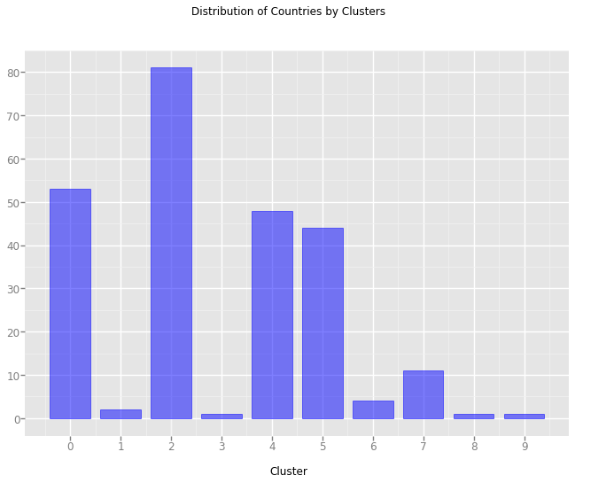
Methods
I used a clustering algorithm, a technique I choose because it is unsupervised, as it is not driven by bias but that can discover groupings only based on the data:

Slide 8
Findings
I could discover a very interesting cluster that grouped together renowned countries for their development level but also others (bolded) that I would have never thought about before this analysis:
‘Australia', 'Austria', 'Bahrain', 'Belgium', 'Canada', 'Cyprus', 'Czech Republic', 'Denmark', 'Estonia', 'Finland', 'France', 'Germany', 'Greece', 'Hong Kong SAR, China', 'Iceland', 'Ireland', 'Israel', 'Italy', 'Japan', 'Korea, Rep.', 'Latvia', 'Lithuania', 'Luxembourg', 'Macedonia, FYR', 'Netherlands', 'New Zealand', 'Norway', 'Poland', 'Portugal', 'Singapore', 'Slovak Republic', 'Slovenia', 'Spain', 'Sweden', 'Switzerland', 'United Arab Emirates', 'United Kingdom', 'United States'

Slide 9
Limitations, further steps and conclusion (1):
We can rerun the algorithm excluding the countries inside clusters we think are not interesting, this way in the second run the analysis will be of finer grains.
We decided to use all of the variables we have to gain depth in our analysis, but of course there are some that can be dropped altogether if are deemed of no interests for the user.
There are many various steps one can apply now: delete some variables of choice, delete some rows (like World, Euro area, middle income, etc...) and then rerun the algorithm with a equal or different number of clusters.
When we set for a cluster that we really like, we can employ an analysis of the trend of the countries of that cluster, reinserting a number of years that we think is useful, like 5 or 10, and running some forecasting techniques.

Slide 10
Limitations, further steps and conclusion (1):
Kaggle conducted a very interesting survey on the state of Data Science in 2017 (https://www.kaggle.com/surveys/2017), there are surely some data there that we can merge in to gain some more insights
When we are done with our analytical mindset, let's use our heart a little and give a score for every candidate country in parameters like weather, nature, culture, food, nightlife and anything else we care about.
If we treat those parameters like variables of a data frame, it will be enough to sum each rows to have a total score, a clear indication of which country seems like a good choice to build our career in and maybe that is a country we would have never thought before using a conventional mindset.

